Slide 1

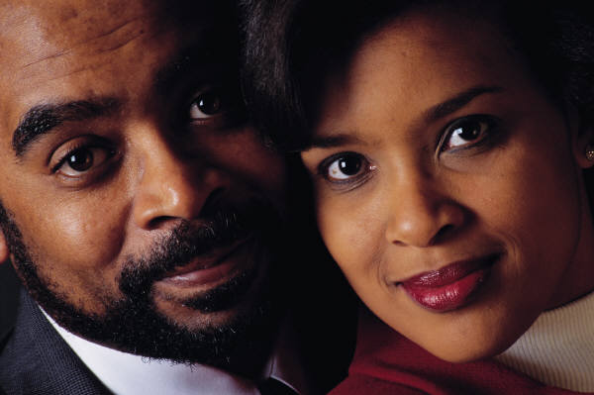
Marriage Communication:
The Rules of Engagement
Jim Sutherland, Ph.D.
Reconciliation Ministries Network
RMNI.org

Slide 2


Marriage is Magnificent
Eve was presented to Adam as a gift—the most beautiful girl in the world! His response, in the Hebrew, was “WOW!!”
A wife is a sign of God’s favor (Prov. 19:14)—a “good thing.”
Married men live longer than single or divorced men.

Slide 3

Marriage is Awesome
Mutual sexual joy (Prov. 5:15-21)
A noble wife “crowns” him (Prov. 12:4)
She is man’s “glory” (1 Cor. 11:7).
The gift (grace) of life is enjoyed together (1 Pet. 3:7).

Slide 4
Communication Derives from the Trinity
Father
Holy Spirit
Son
The Father loved the Son before the world began (John 17:24). The Spirit was sent by the Son through the Father (John 15:26).

Slide 5

Words come from the heart—Matt. 12:33-37—either regenerate or not.
Evil words come from an evil heart, although good words may be flattery.
Salvation should improve our conversation (Eph. 4:29; 5:4).
Neither sex is morally superior, even considering socialization.

Slide 6

We DO Communicate
By Word, Deed, Omission, Non-verbal communication (actions speak louder than words)
The question is: How Christ-like is our communication?
  When reviled He didn’t retaliate or threaten, nor was there any deceit within Him (1 Pet. 2:22-23).
Genuine communication is self-revelation, which has risks. No risk, no deep hurt.
Are they communicating?

Slide 7

The Wedding—a summit of Communication
Lovers reveal more and more of themselves, until in marriage they are naked*.
At marriage we’ve revealed enough to mutually decide that we want to spend life together. You’ve selected each other.
Your phone bills have been crazy and you can’t get spend enough time together.
*Pastor Joe Novenson

Slide 8

Communication potholes appear
Physical issues:
  Hormones or lack of hormones
  Sexual dysfunction
    We grant a sexual monopoly—when frustrated God allows nowhere else to turn and a spouse can become bitter.
  Aging—sickness and loss of beauty and physique

Slide 9

Gender Issues
Males are more left-brained and linear in thinking and women more right-brained and global thinkers.
“Intuition” vs. logic
Women are more verbal than are men.

Slide 10


Communication Issues
Over-familiarity (“For richer, for poorer, but not for lunch.”)
Wrong priorities
  Workaholism
  Focus upon children rather than upon spouse
  Intrusion of in-laws
  Self-centeredness—lack of interest in mate

Slide 11

Sin Separates
Unforgiveness and resentments
Contentiousness and chronic nagging
  Prov. 27:15-16—can’t restrain her
  Prov. 21:9,19—seek solitude
Lying undermines all future communication (one of the qualities sought in single’s ads is honesty)

Slide 12

Sin Separates
A house divided cannot stand (Matt. 12:25). If his half of the marriage boat sinks, so will yours. If you strike at each other, you’ll put holes in the boat, and you’ll both go down.
  We lose when we wound our mate. A wounded spouse is a liability, not an asset, to the marriage.

Slide 13

God comes before our spouse.
Luke 14:26—God comes before our spouse and sometimes His service comes before our spouse.
  However, we must provide for our family, even if it means less time in ministry (1 Tim 5:8).
Jonathan Goforth and Rosalyn Goforth in China around 1900 faced long separations for the Kingdom.
The issue: “Is God asking me to do this, or am I driven by something else?”

Slide 14
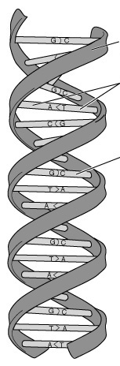
The Double Helix
I don’t believe that communication is static for long, but is traveling either upward or downward—toward edification or destruction.
The connectors illustrate the many opportunities to change direction upward or downward, depending upon our words or actions.

Slide 15
The Double Helix
Downward spirals indicate increasing antagonism and disdain. Upward spirals increase affirmation and love messages.
Eph. 4:29 “Do not let any unwholesome talk come out of your mouths, but only what is helpful for building others up, according to their needs, that it may benefit those who listen.”

Slide 16

Communication myths 1
Good communication = agreement
  2 Cor. 13:11— “one mind” ≠ same opinion
  “Christians…should be united in what is essential, namely, in the love and doctrine of Christ” (Philip E. Hughes) See Phil. 2:1-2.
  Otherwise a minority opinion in the church would be a sin, we’d all have to be in the same political party and the Protestant Reformation would have been sinful.

Slide 17
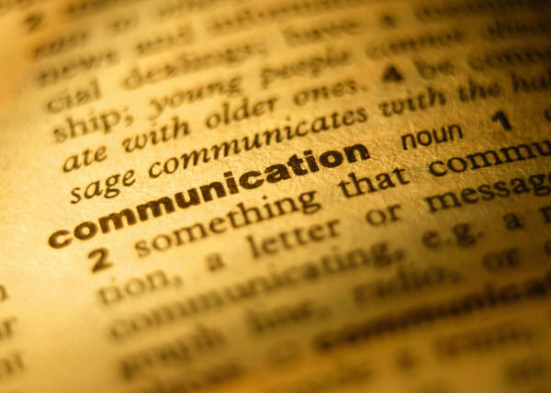
Communication Myths 2
If you disagree, keep talking
  We should not let the sun go down on our anger (Eph. 4:26)
  Maybe we should go pray or calm down.
  Then make an appointment to continue the discussion.
  Prov. 30:33 “For as churning the milk produces butter, and as twisting the nose produces blood, so stirring up anger produces strife.” Don’t cross the threshold into strife—even when ridiculed.

Slide 18
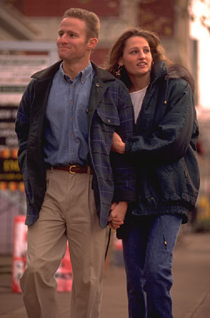
For Better Communication:
Live a life of love—Eph. 5:1-2—which will solve half of communication problems.
  Love is patient, kind, doesn’t envy, doesn’t boast, isn’t proud, isn’t rude, isn’t self-seeking, isn’t easily angered, and doesn’t keep a record of wrongs (1 Cor. 13:4-5)
  Love doesn’t “delight in evil, but rejoices with the truth. It always protects, always trusts, always hopes, always perseveres.” 13:6-7
  Now, how can you pick an argument with that kind of love?

Slide 19

Better Communication
Lose your life (Mark 8:34-35) Die to self in sacrifice to the spouse. Do what you can’t stand to do, for the sake of the other.
  Decide to lose your life for your spouse on a moment-by-moment basis.
  “In humility consider others better than yourselves.” (Phil. 2:3, NIV).

Slide 20

Better Communication
Listen (James 1:19) so that you could repeat what was said.
Don’t interrupt. “He who answers before listening—that is his folly and his shame” (Prov. 18:13).
Don’t admit to wrongdoing just to keep the peace. That is lying (affirming something is true that isn’t—see Colossians 3:9).

Slide 21

Avoiding Arguments
Consider your words before speaking
  “The heart of the righteous ponders how to answer.
  But the mouth of the wicked pours out evil things.” (Prov. 15:28).
  “There is one who speaks rashly like the thrusts of a sword, but the tongue of the wise brings healing.” (Prov. 12:18).
  “If anyone considers himself religious and yet does not keep a tight rein on his tongue, he deceives himself and his religion is worthless.” James 1:26
Avoid attributing motives—we can say what motives appear to be. God knows the heart.
Use “I” messages instead of “you” messages—which is less threatening. “I feel…” rather than “You are always…”

Slide 22
Avoiding Arguments
Don’t get physical. Don’t push, slap, shove or hit. Stay out of your spouse’s face.
Avoid extreme thinking and talking. “You always…You never…Every time I…” Rarely is the other person at the extreme.
Avoid the burdens of history—dredging up the past.
  Col. 3:12 “And so, as those who have been chosen of God, holy and beloved, put on a heart of compassion, kindness, humility, gentleness and patience; bearing with one another, and forgiving each other, whoever has a complaint against anyone; just as the Lord forgave you, so also should you.”

Slide 23
Arguing Fairly
Don’t deal with criticism by shifting blame. Admit when you’re wrong and ask forgiveness. Don’t deny or ignore it. Otherwise you are dishonest, and the wound will take longer to heal between you.
  Say “You’re right, I’m wrong, please forgive me.”
There’s a place for rebuke (Prov. 28:23), and a wise person values a proper rebuke.

Slide 24
Unresolved Arguments
If accurate rebuke has been meekly given and ignored or rejected, this qualifies the person as a mocker (Prov. 9:8).
If there is no resolution, perhaps it is best to “cover over” the offense (Prov. 17:9) with love.
How often are we to forgive our spouse for unresolved sin? Jesus suggested 70 times 7, probably indicating a perfect number of times (Matt. 18:21-22). If we stop forgiving, the marriage will wither and die. At this point we may need to seek marriage counseling from a mature Christian counselor.

Slide 25

Enjoy Sex With Your Wife
I think that half of all marriage problems could be precluded if sexual desires were properly met. Have fun! Read the Song of Solomon together.
  Good sexual communication enhances good verbal communication and vice-versa.
  A good sex life covers a multitude of evils.

Slide 26

Sexual Communication
  Share specifically what pleases you and what doesn’t. We don’t have to conform to every desire, but we may find a middle way. If your spouse is unwilling to do something, don’t, but “test the waters” later (Tim Anastasi).
  Rejection in sex is particularly painful, going to the roots of our basic identity—as male or female.
  We’ve already given sexual rights and cannot rightly take them back.
  The husband needs to sacrifice his own pleasure at times, for his wife’s.

Slide 27
Progress in your Sexual Practice
“Keep it interesting”—my mother-in-law.
Try different sexual positions and places and make it an “event.”
Praise your spouse’s sexual performance and body.
Great sex can begin with helping your wife in the kitchen.
Be sure to wash and have a pleasing aroma about you.

Slide 28


Communication Issues
Sexual communication
  What we wear for our mate is a powerful communicator. Look attractive. If you’re undesirable with the lights on, you may be undesirable with the lights off.
  Dress to please your spouse.
  Stewardship includes developing your body. Keep muscle tone and keep in shape. By 2008 39% of Americans may be 30 lbs. overweight*.
*Nanci Hellmich, “Obesity rate could reach nearly 40% in 5 years,” USA Today, 2/7/03, p. 4A.

Slide 29

Sin Issues
Acted-upon attraction to others is sin
  Pornography, adultery, flirtations, coveting another spouse (Ex. 20:17)
  Attraction to others increases with unhappiness in marriage—
    failure of a spouse to perform his/her roles
    negative communication
    little recreational companionship
    boredom in the bedroom

Slide 30
Giving Strangers Our Eyes
We communicate sexual attraction by our eyes and voice. Staring at the opposite sex or meeting a stare communicates that I find that person sexually attractive and that I am in some way available.
  A woman can capture a man simply with her eyes.
    “Do not lust in your heart after her beauty or let her capture you with her eyes.” Prov. 6:25.
  If a man is captured, he will find it difficult to give himself fully to his wife. If a wife has returned sexually-loaded stares, she will find it difficult to give herself fully to her husband.

Slide 31
Giving Strangers Our Eyes
  If she is married, she has become unfaithful, in spirit, to her marriage vows of keeping herself only for her husband.
  Even if nothing more comes of it, an illicit invitation has been extended to a man. The wife must repent of this unfaithful spirit, asking for a chaste spirit. A husband who has eyes of a predator, seeking a woman who will give access, must also repent and ask for a chaste spirit.
  The husband is supposed to protect the wife from strange men. Instead of staying under his covering, she renounces his authority by inviting illicit and potentially adulterous attention.

Slide 32
Giving A Stranger Our Eyes
A woman who gives her eyes to a strange man cannot communicate a limit to her availability, which can be very dangerous. She invites him to come.
  Given an opportunity, the man will come to the woman. If they find themselves alone, without danger of interruption, she will find it extremely difficult to resist him, since she has already communicated her willingness to receive him.
  Satan is expert at providing such opportunities.
According to one study, 17% of divorces occurred due to adultery, which probably began with the eyes.

Slide 33

Communication and Kids
Children must not usurp the place of the husband. We aren’t married to the kids—nowhere are supposed to take vows with our children. They will leave. Our mate shouldn’t.
The wife should provide counsel to the husband and he should evaluate the counsel.
Children, as you know, will probably try to divide parents to get their way. So communicate with each other if you suspect the kids are playing you against each other.

Slide 34

Communication and Money
Don’t have financial secrets. Share what and where assets are.
  Have joint accounts, generally.
  Avoid large “his” and “her” accounts, which foster an independent spirit.
  The husband shouldn’t keep back funds for himself without giving such funds to his wife.
  Agree upon a monthly budget
  Establish an emergency fund of at least 2-3 months’ income.

Slide 35

Communication and Money
Allow the more gifted one to keep the figures, but cooperate.
Provide financial security to the wife.
Agree upon long-range financial goals, such as being debt-free, savings goals, etc.
Slothfulness and lack of self-control—both spiritual problems—are exposed with finances.

Slide 36

Communication and Prayer
Probably the deepest levels of communication come as you share prayer needs and pray together.
  Worries and concerns, otherwise undiscovered, emerge.
  Evangelicals divorce at a slightly higher rate than the general public. Satan targets these marriages.
  God provides a ready-made
  prayer partner with whom you
  can agree (Matt. 18:19) at any
  time—a gift of God.

Slide 37
Stewardship of the Wife
A husband is his wife’s “gardener.” Communicate, wife, how you feel you need to develop and maximize God’s gifts to you in the areas of hobbies, vocation, talents, and interests.
Developing her gifts will cost money.
I believe the husband will be
called to account if he has buried his wife’s talents.

Slide 38

Stewardship of the Husband
Encourage him to develop his abilities. Don’t compete with him, but encourage and admire him.
  When he is in most harmony with his work, the home will have more harmony.
  My wife fully supported me in getting further education, even though it meant my being far away for 9 months with 3 kids at home and that she would be the general contractor of the house we were building.

